Slide 1
Human Computer Interaction
The computer part IV
Display Devices
bitmap screens (CRT & LCD)
large & situated displays
digital paper
(output devices)
CS 8th Semester

Slide 2
Display Devices
Bitmap Screens (CRT & LCD)
Large & Situated Displays
Digital Paper

Slide 3
Bitmap Displays – Resolution and Color
Virtually all computer displays are based on some sort of Bitmap.
“That is the display is made of vast numbers of colored dots or pixels in a rectangular grid.”
These pixels may be:
limited to black and white (for example, the small display on many TV remote controls),
or may be in grayscale,
or may be having full color.

Slide 4
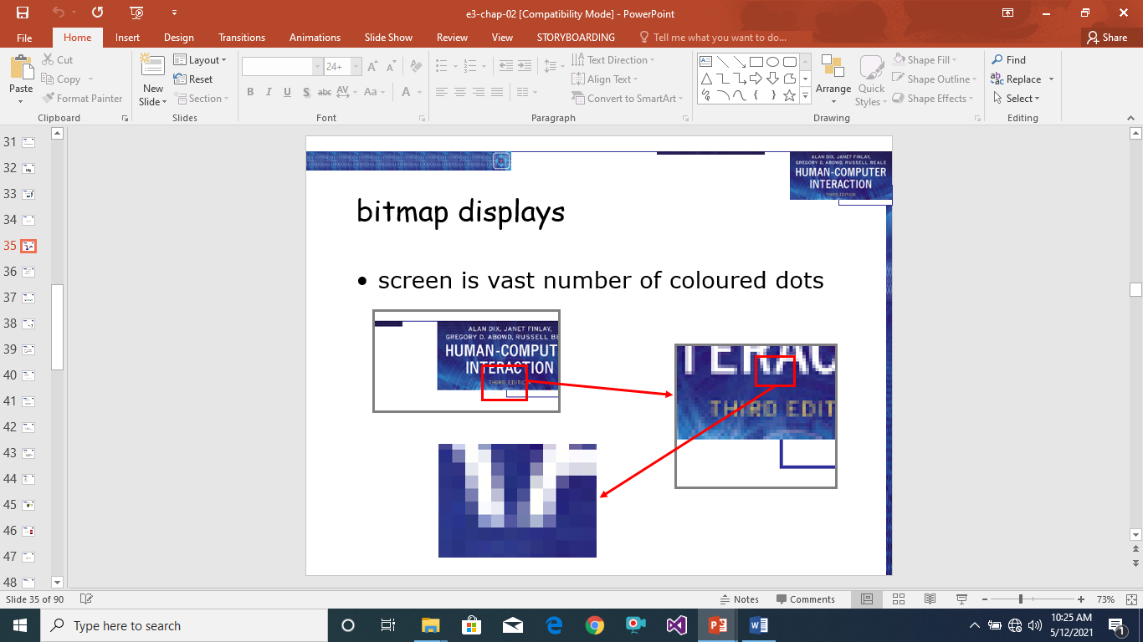
Bitmap Displays – Resolution and Color

Slide 5
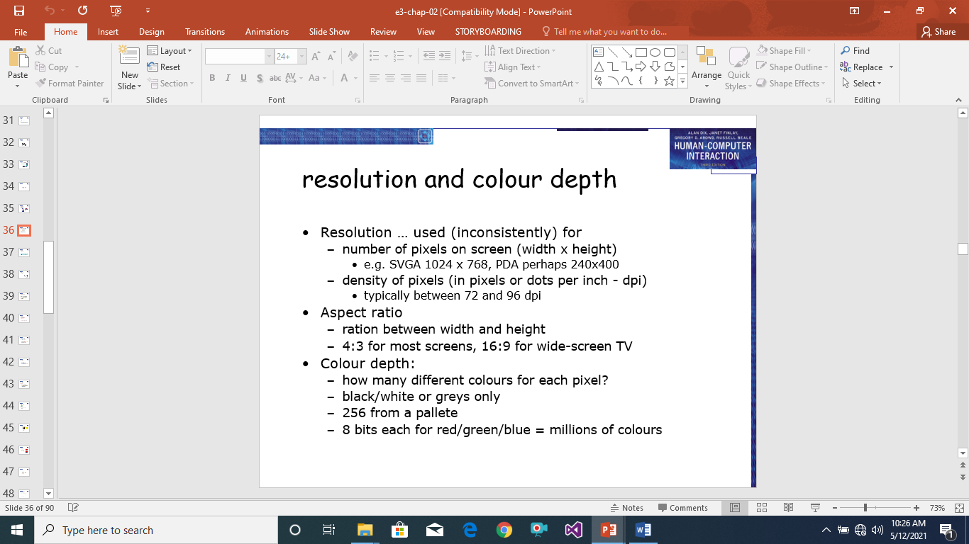
Bitmap Displays – Resolution and Color

Slide 6
Cathode Ray Tube
The cathode ray tube is the television-like computer screen still most common as we write this, but rapidly being displaced by flat LCD screens.
It works in a similar way to a standard television screen. A stream of electrons is emitted from an electron gun, which is then focused and directed by magnetic fields. As the beam hits the phosphor-coated screen, the phosphor is excited by the electrons and glows. The electron beam is scanned from left to right, and then flicked back to rescan the next line, from top to bottom.
This is repeated, at about 30 Hz (that is,30 times a second), per frame, although higher scan rates are sometimes used to reduce the flicker on the screen. Another way of reducing flicker is to use interlacing, in which the odd lines on the screen are all scanned first, followed by the even lines. Using a high-persistence phosphor, which glows for a longer time when excited, also reduces flicker, but causes image smearing especially if there is significant animation.

Slide 7
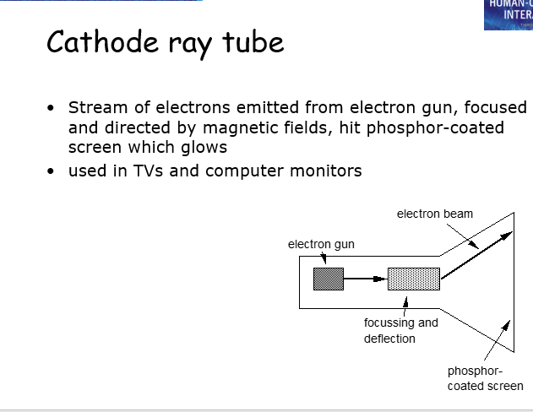

Slide 8
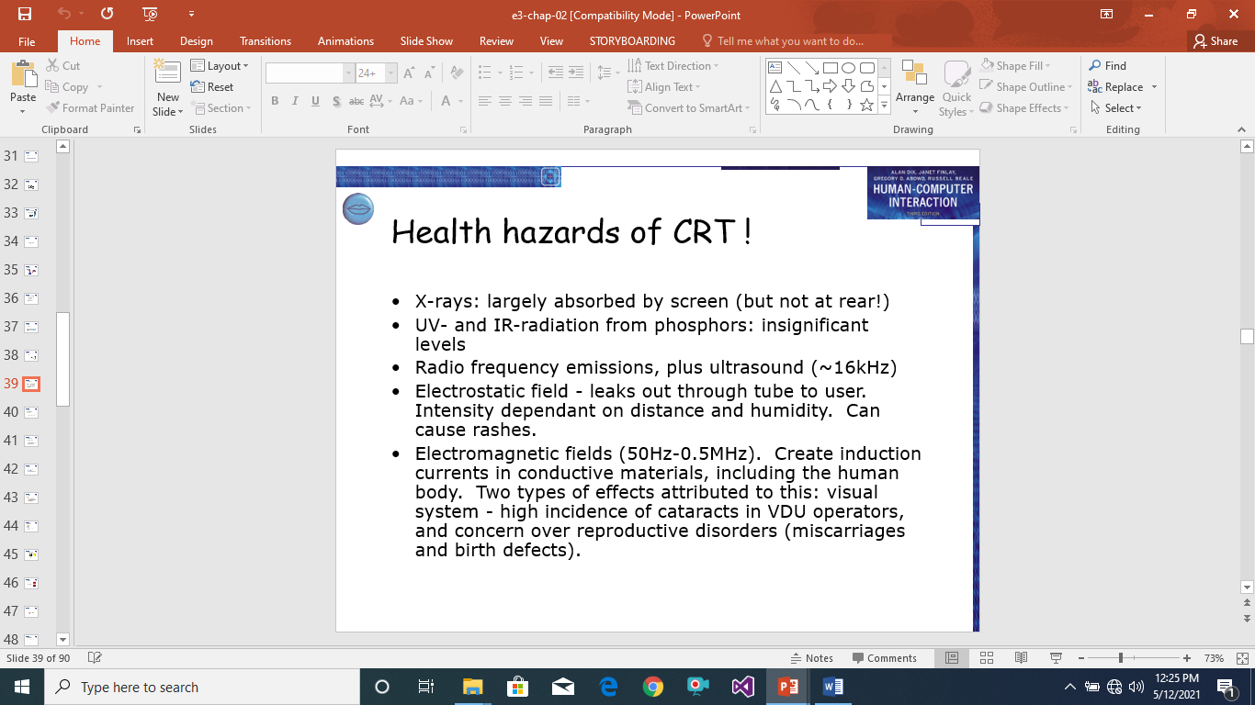

Slide 9
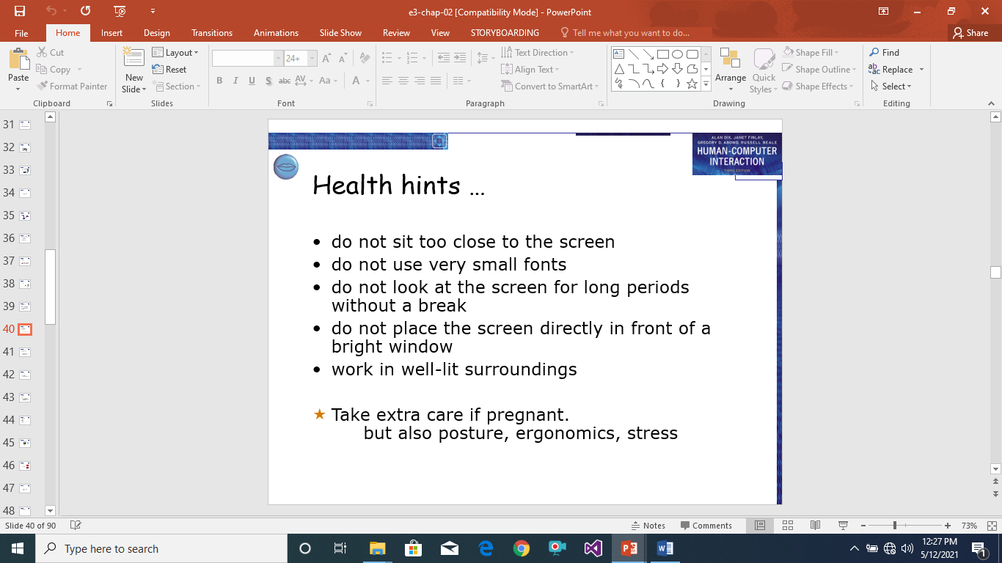
Digitized Tablet

Slide 10
Liquid Crystal Display (LCD)
If you have used a personal organizer or notebook computer, you will have seen the light, flat plastic screens, LCDs.
These displays utilize liquid crystal technology and are smaller, lighter and consume far less power than traditional CRTs.
These are also commonly referred to as flat-panel displays.
They have no radiation problems associated with them, and are matrix addressable, which means that individual pixels can be accessed without the need for scanning.

Slide 11
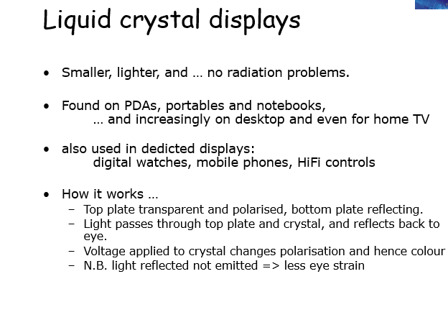
Eye Gaze

Slide 12
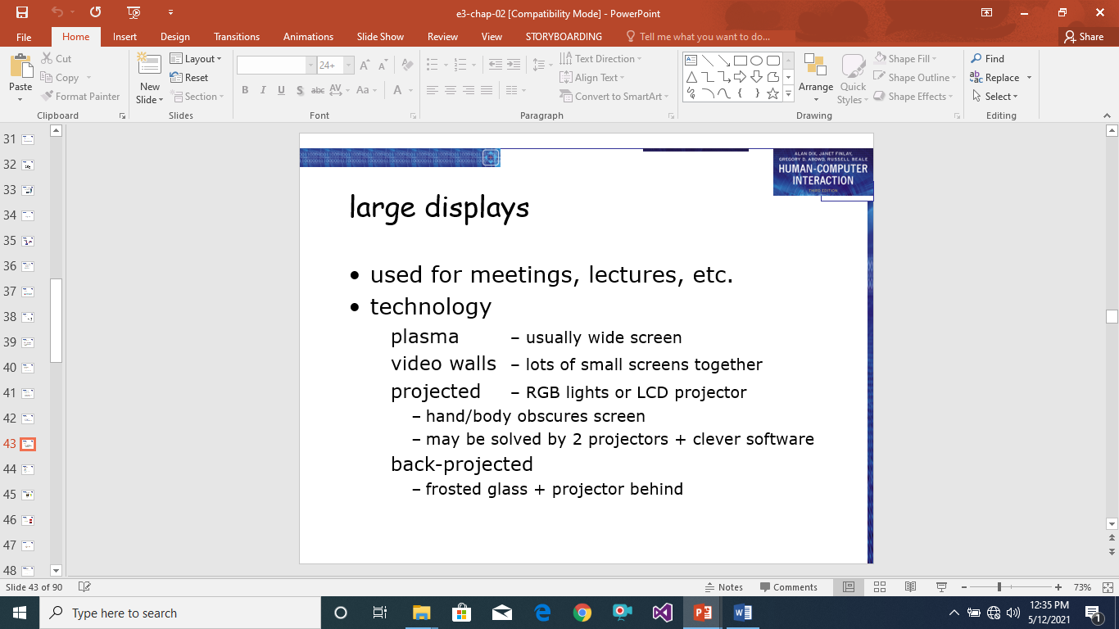
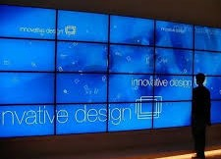
Eye Gaze

Slide 13
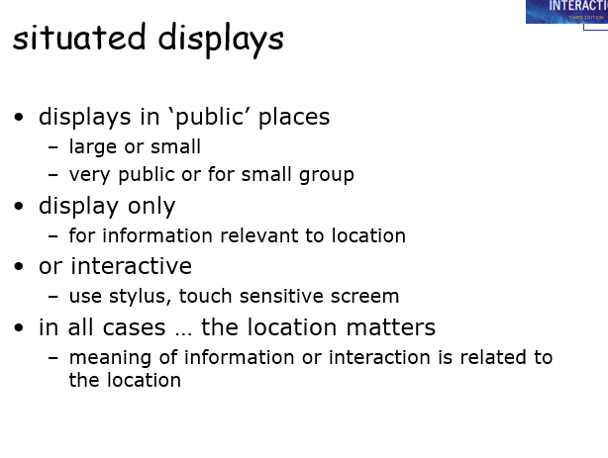
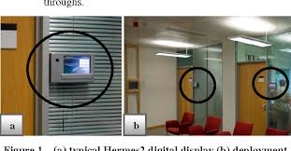
Cursor Keys

Slide 14
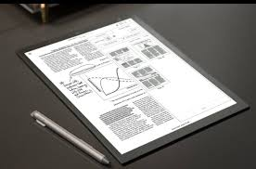
Digital paper
A new form of ‘display’ that is still in its infancy is the various forms of digital paper. These are thin flexible materials that can be written to electronically, just like a computer screen, but which keep their contents even when removed from any electrical supply.

